Slide 1
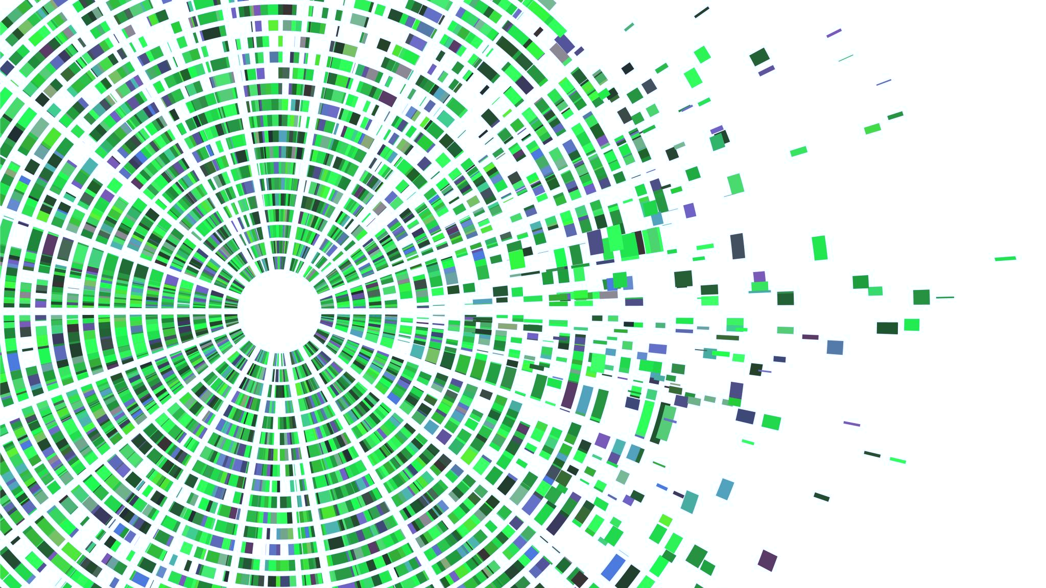
PROJECT 18. AUTOMATIC TEXT SUMMARIZATION
ARMI KORHONEN
NIINA MÄKINEN
TEEMU HERTTUA
JASMIN AL AMIR

Slide 2
ABSTRACT
Project 18: Automatic text summarization
Extractive single document summarization and evaluation with in-built information retrieval and graphical user interface

Slide 3
PROJECT DESCRIPTION
Features of the project are the GUI through which URL of the text can be submitted
GUI Features:
User input (Dailu Mail Article)
Summarizer selection
Output summary review

Slide 4
THEORY

Slide 5
GROUP RESPONSIBILITIES

Slide 6
DATA SOURCES

Slide 7
TECHNOLOGIES AND TOOLS USED

Slide 8
IMPLEMENTATIONS

Slide 9
RESULTS SO FAR

Slide 10
TIME CHART DIAGRAM

Slide 11
GROUP PROJECT SCHEDULE
20.10.2020
8.11.2020
PHASE A
PHASE B
Completion of GUI:
More options for selections of summarizers
Omplement backend for rouge and spacy
Completing the testing
Performance metrics:
Memory usage
Processor usage
Timing
Comparing against another program
Completing the report
Documentation

Slide 12
GROUP PROJECT SCHEDULE
GUI
PRESENTATION
Current project
REPORT
1
2
3
4
5
6
Completing tool

Slide 13
Project overview: Seminar Presentation Suggested structure for the presentation
Title
Group members
Abstract (one short paragraph)
Topic(s) investigated
Relevant prior work (paper citations, actual systems)
Delineation of group member responsibilities
Data sources
Technologies (programming languages, software, etc.)
Existing tools leveraged
Implementation details
Current results so far
Calendar and time-chart diagram of future tasks till final submission and final product
→ Stick to time of 10 min presentation and up to 2min for questions

